Slide 1

Product Positioning UNIT IV

Slide 2
4 | Product Positioning Experimental analytics, Consumers' utility of product features, Product modification - Traditional conjoint analysis, New product development, pricing decision, market share calculation – Choice- based conjoint analysis, Factor analysis Product Development Design and Development: Preference Regression, The pairwise tradeoff model and the full profile conjoint model | 06

Slide 3
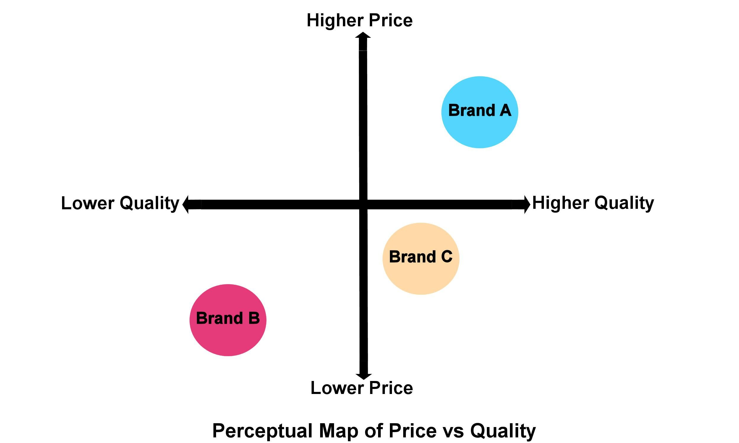

Slide 4
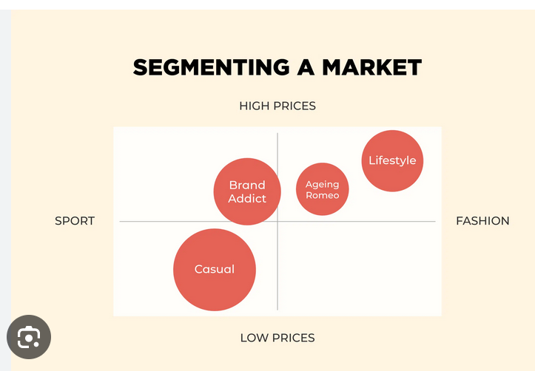

Slide 5
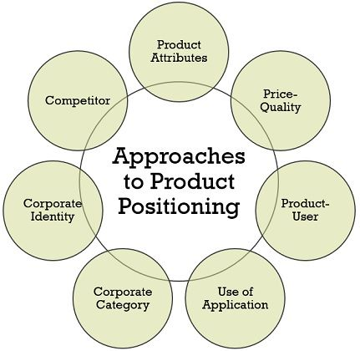

Slide 6
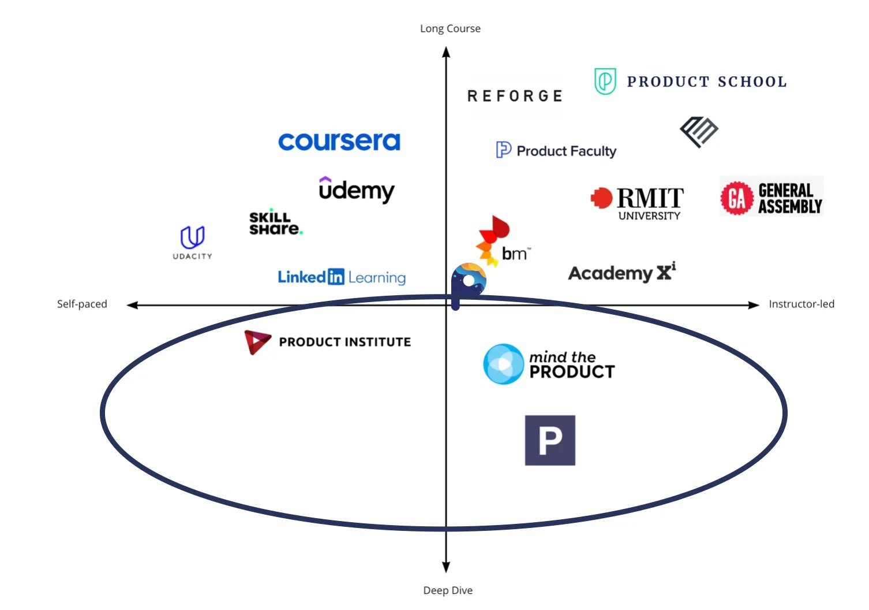

Slide 7
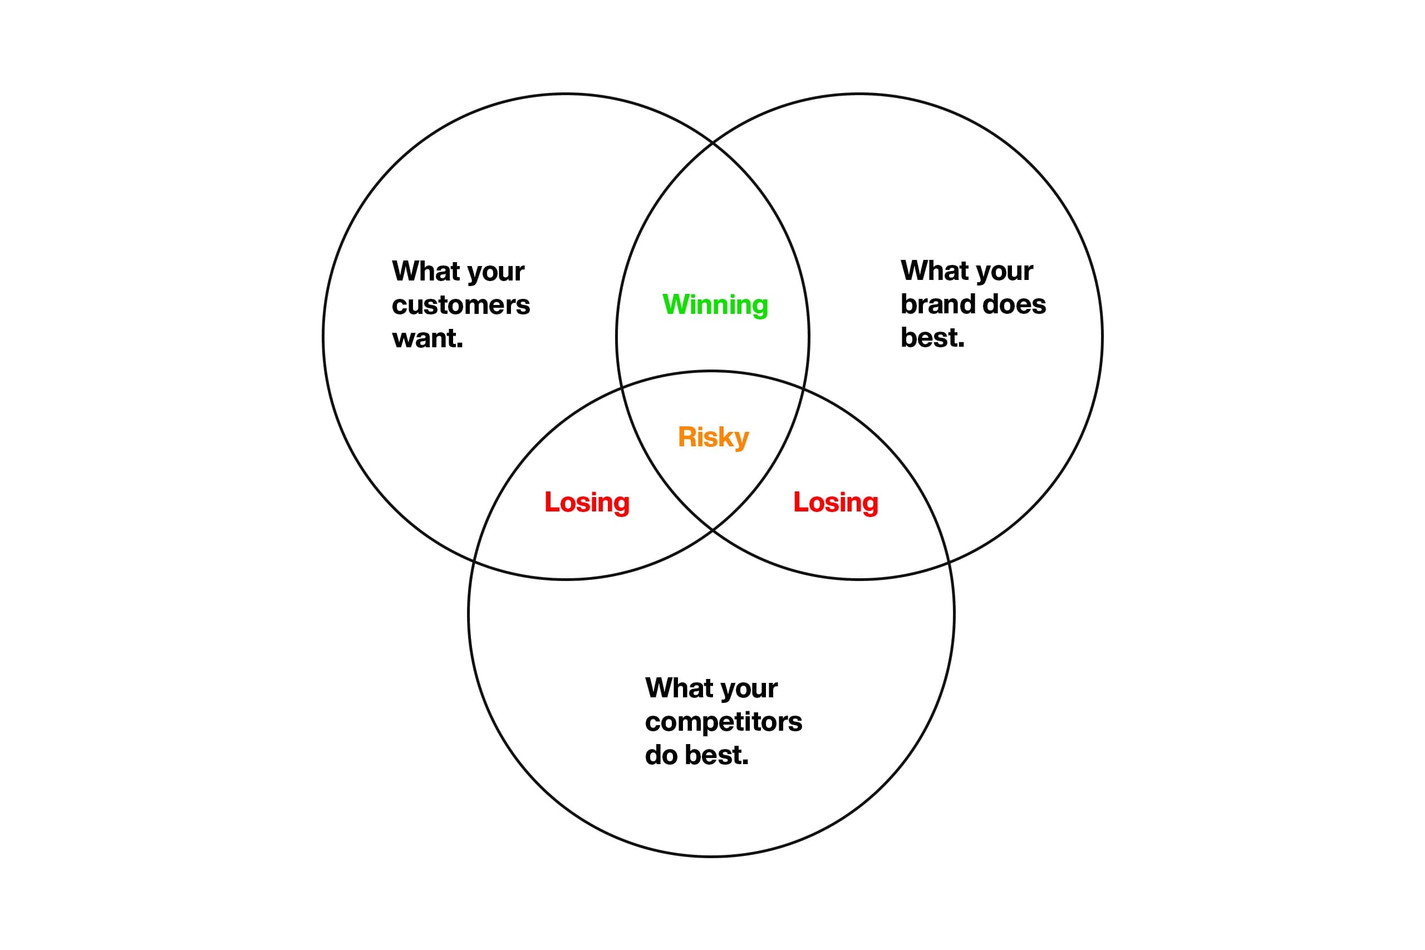
The Basics of Brand Positioning
https://www.smashbrand.com/articles/the-basics-of-brand-positioning/

Slide 8

Experimental analytics
What is the experimental data analysis?
Experimental Data Analysis (EDA) is a software program that helps professionals detect errors in experimental data, find relationships between variables and provides graphical representations of the statistics being analyzed.

Slide 9

Experimental analytics
"Experimental analytics" typically refers to the use of experimental methods and techniques in the field of analytics. Analytics involves the systematic computational analysis of data or statistics, often for the purpose of gaining insights, making informed decisions, and identifying patterns or trends.

Slide 10

Experimental analytics
A/B Testing
Multivariate Testing
Conjoint Analysis
Experimental Design
Machine Learning Experiments
Simulations

Slide 11
Experimental analytics
A/B Testing: This is a common experimental method where two or more versions of something (e.g., a website, an ad, a product feature) are compared to determine which performs better in terms of a specific metric, such as conversion rate or user engagement.

Slide 12
Experimental analytics
Multivariate Testing: Similar to A/B testing, but it involves testing multiple variations of different elements simultaneously to understand the combined impact on a desired outcome.

Slide 13

Experimental analytics
Conjoint Analysis: Used in marketing and product development, conjoint analysis is an experimental approach to understand how different features of a product or service contribute to its overall appeal. This helps in optimizing product design or pricing strategies.

Slide 14

Experimental analytics
Experimental Design: This involves planning and conducting experiments in a controlled manner to test hypotheses and draw valid conclusions. This can be applied in various domains, including marketing, finance, and operations.

Slide 15

Experimental analytics
Machine Learning Experiments: In the context of machine learning and data science, experimental analytics may involve conducting experiments with different algorithms, hyperparameters, and feature selections to find the best model for a given problem.

Slide 16
Experimental analytics
Simulations: Running simulated experiments to model real-world scenarios. This is common in fields like finance, where analysts might simulate different market conditions to understand the potential outcomes of different strategies.

Slide 17

Consumers' utility of product features

Slide 18
Consumers' utility of product features
Consumers' utility of product features refers to the satisfaction or value that consumers derive from specific attributes or characteristics of a product. Different consumers may assign different levels of importance to various features based on their preferences, needs, and priorities. Understanding consumers' utility of product features is crucial for businesses as it helps them design and market products that

Slide 19
Consumers' utility of product features
Individual Preferences
Functional Benefits
Quality and Durability
Innovative and Unique Features
Convenience and Ease of Use

Slide 20
Consumers' utility of product features
Individual Preferences: Different consumers prioritize product features differently based on their unique preferences and requirements. For example, some may prioritize performance, while others may value aesthetics or ease of use more.

Slide 21
Consumers' utility of product features
Functional Benefits: Consumers often seek products that fulfill specific functional needs. Features that enhance the product's performance, reliability, or functionality are likely to have a higher utility for users.

Slide 22
Consumers' utility of product features
Quality and Durability: The perceived quality and durability of a product significantly impact consumer satisfaction. Features that contribute to a product's longevity and robustness can enhance its utility.

Slide 23

Consumers' utility of product features
Innovative and Unique Features: Novelty and innovation can capture consumers' attention. Products with unique or cutting-edge features may have higher utility, especially for early adopters who appreciate the latest technologies.

Slide 24

Consumers' utility of product features
Aesthetics and Design: Some consumers place a premium on the visual appeal and design of a product. Features related to aesthetics, style, and overall design can contribute to the overall utility of a product.

Slide 25
Consumers' utility of product features
Convenience and Ease of Use: Consumers often appreciate products that are user-friendly and convenient to use. Features that simplify tasks or enhance the overall user experience contribute positively to utility.

Slide 26
Consumers' utility of product features
Cost-Benefit Analysis:
Consumers often conduct a mental cost-benefit analysis when evaluating products. They assess whether the utility provided by certain features justifies the price of the product.

Slide 27

Consumers' utility of product features
Adaptability and Innovation:
Consumer preferences may evolve over time, influenced by technological advancements, social trends, or changes in cultural norms.
Companies need to stay adaptable and innovative to meet shifting consumer demands and stay ahead in the market.

Slide 28

Consumers' utility of product features
Customization and Personalization:
Offering customizable or personalized features allows consumers to tailor the product to their preferences, increasing overall satisfaction.

Slide 29
Conjoint Analysis

Slide 30

Conjoint Analysis
Traditional conjoint analysis is a market research technique used to understand consumers' preferences for different product attributes. It helps businesses identify the optimal combination of features that will maximize customer satisfaction and market success. Conjoint analysis is particularly useful in situations where a product or service can be described by multiple attributes, and the goal is to determine the relative importance of each attribute.

Slide 31
What is Conjoint Analysis?
Conjoint analysis is a popular method of product and pricing research that uncovers consumers’ preferences, which is useful when a company wants to:
Select product features.
Assess consumers’ sensitivity to price changes.
Forecast its volumes and market share.
Predict adoption of new products or services.
https://conjointly.com/guides/what-is-conjoint-analysis/

Slide 32
What is Conjoint Analysis?
Conjoint analysis is frequently used across different industries for all types of products,
such as consumer goods,
electrical goods,
life insurance plans,
retirement housing,
luxury goods,
and air travel.
It is applicable in various instances that centre around discovering what type of product consumers are likely to buy and what consumers value the most (and least) about a product. As such, it is a familiar tool for marketers, product managers, and pricing specialists.

Slide 33
What is Conjoint Analysis?
Businesses of all sizes can benefit from conjoint analysis, including even local grocery stores and restaurants — and its scope is not just limited to consumer contexts, for example, charities can use conjoint analysis’ techniques to find out donor preferences, while HR departments can use it to build optimal compensation packages.

Slide 34

New product development​

Slide 35
New product development
Idea Generation
Idea Screening
Concept Development and Testing
Business Analysis
Prototype Development
Market Testing
Commercialization
Post-Launch Evaluation
Continuous Improvement

Slide 36

New product development
New Product Development (NPD) is a systematic process used by companies to bring a new product or service to the market. Successful new product development involves various stages, from idea generation to product launch.

Slide 37

New product development
Idea Generation:
This is the starting point of new product development. Ideas can come from various sources, including customer feedback, market trends, internal brainstorming sessions, competitor analysis, and technological advancements.

Slide 38

New product development
Idea Screening:
The goal is to evaluate and filter out impractical or unfeasible ideas. Criteria such as market potential, technical feasibility, and alignment with company goals are considered during this stage.

Slide 39

New product development
Concept Development and Testing:
Develop detailed concepts for the selected ideas and present them to a target audience for feedback. This stage helps refine the concepts and identify potential issues or improvements.

Slide 40
New product development
Business Analysis:
Conduct a comprehensive analysis to assess the financial viability of the product. This includes estimating costs, sales projections, and potential profitability. It's also important to consider the impact on existing product lines and the overall business strategy.

Slide 41
New product development
Prototype Development:
Create a prototype or a minimum viable product (MVP) to test the product's design and functionality. Prototypes can be physical products, digital simulations, or other representations that allow for testing and iteration.

Slide 42
New product development
Market Testing:
Test the product in a limited market to gather real-world feedback and assess its performance. This step helps identify any issues that may not have been apparent during the development and prototype stages.

Slide 43
New product development
Commercialization:
If the market testing is successful, proceed with full-scale production and launch the product to the broader market. This involves developing marketing strategies, distribution plans, and sales tactics.

Slide 44
New product development
Launch:
Execute the product launch plan, including promotional activities, advertising, and communication with stakeholders. Ensure that all aspects of the launch, from production to marketing, are coordinated effectively.

Slide 45

New product development
Post-Launch Evaluation:
Monitor the product's performance in the market and gather customer feedback. Evaluate sales figures, customer satisfaction, and any necessary adjustments needed to improve the product or marketing strategies.

Slide 46

New product development
Continuous Improvement:
NPD is an iterative process. Use the insights gained from the post-launch evaluation to inform future product development efforts. Continuously innovate and adapt to changing market conditions.

Slide 47
New product development
Successful new product development requires cross-functional collaboration, market research, and a thorough understanding of customer needs and preferences. It also involves risk management and the ability to adapt to unforeseen challenges. Companies that excel in NPD often foster a culture of innovation, encourage employee creativity, and stay attuned to emerging trends in their industry.

Slide 48
Pricing decision

Slide 49
Pricing decision
Pricing is a critical element in the marketing mix and plays a pivotal role in the success of a product or service. Pricing decisions involve determining the optimal price point that both maximizes revenue and meets customer expectations.

Slide 50

Pricing decision
Costs:
Market Demand:
Competitive Pricing:
Value-Based Pricing:
Psychological Pricing:
Dynamic Pricing:
Promotional Pricing:
Distribution Channels:
Legal and Ethical Considerations:
Global Considerations:

Slide 51
Pricing decision
Costs:
Calculate the production and operational costs associated with the product or service. This includes variable costs (directly tied to production) and fixed costs (overheads such as rent, salaries, etc.).
Determine the desired profit margin, considering the financial goals and objectives of the business.

Slide 52

Pricing decision
Market Demand:
Understand the demand for the product or service in the target market. Analyze how price changes may affect consumer demand and purchasing behavior.
Consider elasticity of demand, which measures the responsiveness of quantity demanded to changes in price.

Slide 53
Pricing decision
Competitive Pricing:
Analyze the pricing strategies of competitors. Determine whether the product will be positioned as a premium, economy, or mid-range offering.
Assess the unique value proposition and differentiation factors that may justify a higher or lower price compared to competitors.

Slide 54

Pricing decision
Value-Based Pricing:
Set prices based on the perceived value of the product or service to customers. This approach focuses on what customers are willing to pay for the benefits received.
Understand the features, quality, and overall customer experience that contribute to the perceived value.

Slide 55

Pricing decision
Psychological Pricing:
Utilize pricing strategies that consider the psychological factors influencing consumer perception. For example, pricing something at $9.99 may be more appealing than $10.00 due to the left-digit effect.
Consider the impact of pricing on customer perceptions of quality and value.

Slide 56
Pricing decision
Dynamic Pricing:
Implement dynamic pricing strategies that allow for adjustments based on real-time market conditions, demand fluctuations, or other variables.
Online retailers, for instance, may use dynamic pricing algorithms to adjust prices based on factors like competitor prices, inventory levels, and customer behavior.

Slide 57
Pricing decision
Promotional Pricing:
Use promotional pricing, discounts, or bundling strategies to stimulate sales during specific periods or to achieve specific objectives.
Be mindful of the impact of promotional pricing on overall brand perception and long-term profitabilit

Slide 58

Pricing decision
Distribution Channels:
Consider the distribution channels through which the product is sold. The pricing strategy may vary depending on whether the product is sold directly to consumers or through intermediaries.
Account for any channel discounts or commissions that may affect the final retail price.

Slide 59
Pricing decision
Legal and Ethical Considerations:
Ensure that pricing practices comply with legal and ethical standards. Avoid deceptive pricing or anticompetitive behavior that could lead to legal consequences and damage the brand's reputation.

Slide 60
Pricing decision
Global Considerations:
If operating in multiple markets, consider regional economic conditions, currency exchange rates, and cultural factors that may influence pricing decisions.

Slide 61
MARKET SHARE CALCULATION

Slide 62

Market share calculation
Market share is a key performance indicator that measures a company's sales revenue or unit sales in comparison to the total market. It is often expressed as a percentage and represents the portion of the market that a business controls.

Slide 63
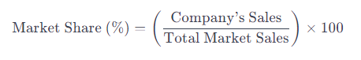
Market share calculation
Company's Sales: This is the total revenue or unit sales generated by the company within a specific time period.
Total Market Sales: This is the aggregate revenue or unit sales for all companies in the market during the same time period.

Slide 64

CHOICE BASED CONJOINT ANALYSIS

Slide 65
Choice based conjoint analysis
Choice-Based Conjoint Analysis (CBC) is a sophisticated market research technique used to understand and quantify customer preferences for different product features and attributes. Unlike traditional conjoint analysis, which involves respondents ranking or rating various product profiles, CBC presents respondents with a series of choice sets, where they must choose their preferred product from a set of alternatives.

Slide 66

Choice based conjoint analysis
Attribute and Level Selection:
Profile Generation:
Choice Sets:
Respondent Choice Data Collection:
Data Analysis:
Utility Estimation:
Market Simulation:
Segmentation Analysis:

Slide 67

Choice based conjoint analysis
Attribute and Level Selection:
Identify the relevant attributes and their corresponding levels that describe the product or service being studied.
Attributes are the features that can be varied (e.g., price, brand, color, size), and levels are the specific values or options within each attribute

Slide 68

Choice based conjoint analysis
Profile Generation:
Create a set of product profiles by combining different levels of attributes. These profiles represent hypothetical product configurations.
Use experimental design techniques to ensure an efficient and balanced presentation of profiles to respondents.

Slide 69
Choice based conjoint analysis
Choice Sets:
Develop choice sets by randomly selecting a subset of profiles for respondents to evaluate.
Each choice set typically includes two or more profiles, and respondents are asked to choose the product they would be most likely to purchase from each set.

Slide 70
Choice based conjoint analysis
Respondent Choice Data Collection:
Administer the choice sets to a sample of respondents through surveys or interviews.
Collect data on respondents' choices, capturing their preferences for different attribute levels.

Slide 71

Choice based conjoint analysis
Data Analysis:
Analyze the choice data using statistical methods, such as hierarchical Bayes or maximum likelihood estimation.
The goal is to estimate part-worth utilities, which represent the perceived value of each attribute level to respondents.

Slide 72

Choice based conjoint analysis
Utility Estimation:
Derive utility scores for each level of every attribute. These scores quantify the relative importance of each attribute and the trade-offs consumers are willing to make.

Slide 73

Choice based conjoint analysis
Market Simulation:
Use the utility scores to simulate market scenarios and predict how changes in product features would impact consumer choices and market share.
Assess the impact of pricing, design variations, or other strategic decisions on overall product preference.

Slide 74

Choice based conjoint analysis
Segmentation Analysis:
Explore potential market segments based on respondent preferences.
Identify clusters of consumers with similar preferences and tailor marketing strategies accordingly.

Slide 75

FACTOR ANALYSIS

Slide 76
Factor analysis
•Variables
•Correlation Matrix
•Factor Model:
•Factor Extraction:
•Factor Rotation:
•Factor Loadings:
•Factor Scores
•Interpretation

Slide 77
Factor analysis
Variables:
Factor analysis begins with a set of observed variables or indicators. These variables can be measures of different aspects of a phenomenon, and they are assumed to be influenced by underlying latent factors.

Slide 78

Factor analysis
Correlation Matrix:
Calculate the correlation matrix for the observed variables. This matrix shows the pairwise correlations between each pair of variables in the dataset.

Slide 79
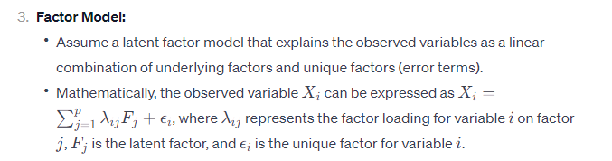
Factor analysis
Factor Model:
Assume a latent factor model that explains the observed variables as a linear combination of underlying factors and unique factors (error terms).
Mathematically, the observed variable ��Xi​ can be expressed as ��=∑�=1������+��Xi​=∑j=1p​λij​Fj​+ϵi​, where ���λij​ represents the factor loading for variable �i on factor �j, ��Fj​ is the latent factor, and ��ϵi​ is the unique factor for variable �i.

Slide 80
Factor analysis
Factor Extraction:
Use factor extraction methods to identify the number of factors to retain. Common methods include Principal Component Analysis (PCA), Principal Axis Factoring, and Maximum Likelihood Estimation.
Eigenvalues, scree plots, and other criteria are often used to determine the optimal number of factors.

Slide 81

Factor analysis
Factor Rotation:
Rotate the factors to achieve a simpler and more interpretable factor structure.
Common rotation methods include Varimax, Promax, and Oblimin.

Slide 82

Factor analysis
Factor Loadings:
Examine the factor loadings to understand the strength and direction of the relationship between each variable and each factor.
Factor loadings represent the correlation between the observed variable and the underlying factor.

Slide 83

Factor analysis
Factor Scores:
Compute factor scores for each observation in the dataset. Factor scores provide a quantitative representation of the influence of each factor for each individual case.

Slide 84

Factor analysis
Interpretation:
Interpret the factors based on the patterns of factor loadings. Factors are often given meaningful labels based on the variables with high loadings on each factor.
Interpretation involves understanding what each factor represents in terms of the underlying constructs or dimensions.

Slide 85
Factor analysis
Factor analysis is widely used in various fields such as psychology, sociology, marketing, and finance for uncovering latent structures in data and gaining insights into the relationships among observed variables. It is important to note that factor analysis assumes certain statistical and structural assumptions, and its results should be interpreted cautiously. Additionally, the interpretation of factors requires domain knowledge and theoretical understanding of the underlying constructs.

Slide 86

Preference Regression

Slide 87
Preference Regression
Regression Analysis:
Discrete Choice Models:
Conjoint Analysis:
Preference Mapping:
Machine Learning Approaches:
Neural Networks and Deep Learning:
Choice-Based Conjoint (CBC) Analysis:

Slide 88
Preference Regression
Regression Analysis:
In the context of preference modeling, regression analysis can be used to understand the relationship between independent variables (features or attributes) and a dependent variable (preference or choice). This can help in predicting preferences based on specific characteristics.

Slide 89
Preference Regression
Discrete Choice Models:
Preference modeling often involves understanding how individuals make choices among discrete alternatives. Discrete choice models, such as logit or probit models, are commonly used for this purpose. These models estimate the probability of choosing a particular alternative based on its attributes.

Slide 90
Preference Regression
Conjoint Analysis:
Conjoint analysis is a specific method used to understand preferences by presenting individuals with different combinations of product or service attributes. By analyzing the choices respondents make, researchers can infer the relative importance of different features.

Slide 91

Preference Regression
Preference Mapping:
Preference mapping involves visualizing and understanding consumer preferences in a multi-dimensional space. It can be done using techniques like multidimensional scaling (MDS) or factor analysis.

Slide 92

Preference Regression
Machine Learning Approaches:
Various machine learning techniques, including decision trees, random forests, and support vector machines, can be employed to model and predict preferences. These methods can handle complex relationships in large datasets.

Slide 93
Preference Regression
Neural Networks and Deep Learning:
Deep learning techniques, particularly neural networks, can be applied to preference modeling tasks. These models can capture intricate patterns in data, but they may require substantial amounts of data and computational resources.

Slide 94
Preference Regression
Choice-Based Conjoint (CBC) Analysis:
As mentioned earlier, CBC is a method that involves presenting respondents with choices among different product or service profiles, allowing researchers to infer preferences based on observed choices.

Slide 97
https://conjointly.com/guides/what-is-conjoint-analysis/#icecreamexample
https://www.linkedin.com/pulse/why-how-does-conjoint-analysis-work-so-well-bryan-k-orme-s8rwc/?trk=public_post_main-feed-card_feed-article-content

